Slide 1

Reproducible Research – 10 steps to working more openly
Sharron Stapleton
Belinda Weaver
Based on a workshop created by Amanda Miotto and Julie Toohey, Griffith University

Slide 2

What is reproducible research?
If you were given the raw data, and the published paper with all the steps taken to get to the conclusion … … you could redo all steps and come up with the same conclusion
Photo by Finn Hackshaw on Unsplash

Slide 3
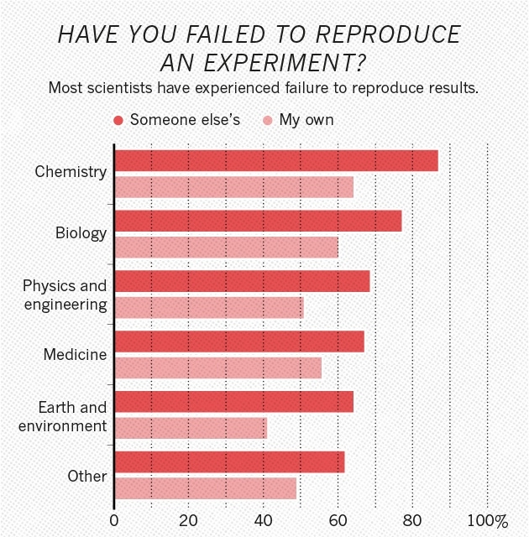

So many fields are over 50%
Baker, M. 1,500 scientists lift the lid on reproducibility. Nature 533, 452–454 (2016). https://doi.org/10.1038/533452a

Slide 4
A paleontology journal has retracted a recent paper after discovering it had published the uncorrected version of the manuscript.
The mistake occurred after the
authors submitted revisions to the manuscript without tracking the changes,
prompting the publisher to believe nothing had been changed and publishing the previous version. The journal initially told the authors it planned to publish an erratum that described the mistake as a production error, but then retracted the paper—seemingly without consulting the authors. However, the authors said they were happy with the outcome. https://retractionwatch.com/2018/01/25/good-news-able-retract-article-journal/

Slide 5
“Definitely embarrassing”: Nobel Laureate retracts non-reproducible paper in Nature journal
A Nobel Laureate has retracted a 2016 paper in Nature Chemistry that explored the origins of life on earth, after discovering the main conclusions were not correct. The initial data had been misinterpreted.
https://retractionwatch.com/2017/12/05/definitely-embarrassing-nobel-laureate-retracts-non-reproducible-paper-nature-journal/

Slide 6
Reflections by authors who discovered their own mistake
In the end, we figured out what had happened (a few rows had shifted when I imported the data into Systat, since I didn’t have a “.” in the data file where we were missing phosphorus data for a particular lake-date.)
…
For me, this experience has changed how I do science. It is a large part of why I have moved to making data and code publicly available right away (I truly hope that reviewers go through the data and code when reviewing a paper!) and why I’ve moved to R for most of my analyses.
Duffy, M. (2016, December 2). On finding errors in one’s published analyses. Dynamic Ecology. On finding errors in one’s published analyses | Dynamic Ecology (wordpress.com)

Slide 7
Sorting Out the FACS: A Devil in the Details
Two labs spent a year trying to work out why they got different results on the same experiment …
Answer: One sample was stirred at speed, the other gently rocked.
Hines, W. C., Su, Y., Kuhn, I., Polyak, K., & Bissell, M. J. (2014). Sorting out the FACS: A devil in the details [Cell reports commentary]. Cell press. http://doi.org/10.1016/j.celrep.2014.02.021

Slide 8

Today we are going to learn 10 steps to safeguard us against these situations
Data quality
Documentation
File naming conventions
Folder structures
Automation
Version control
Backing up to the cloud
Computer security
De-identify data
Publish data with persistent identifiers
Photo by Jukan Tateisi on Unsplash

Slide 9


Data quality – use ‘tidy data’ principles
Each variable is a column
Each row is an observation
Each cell contains one value
Don’t merge cells
Don’t use multiple sheets
Don’t use formatting to convey information
each cell contains one value (either a number or character string)
each variable is in a separate column i.e. the thing you’re measuring, like ‘age’ or ‘temperature’ or ‘height’.
each observation is in a separate row
146 | Kessels Road | Nathan
146 Kessels Road Nathan

Slide 10

Messy data
special characters or encoding issues
inconsistent name case & format
date format variations
whitespace around values
typographical errors, misspellings
incomplete answers
conflicting conventions for data values
Tidy data
consistent
easy to analyse
missing data can be coded

Slide 11
Identify and code illegal or missing values
An illegal value is data that does not fall within the accepted range for the variable, e.g.,
age variable with a value of 200 or 355
postcode variable with value of seven digits
Use data validation to prevent this happening.
A missing value is where data may be available but has yet to be entered, or where the data was never collected or recorded. In some cases, observations with missing values may need to be excluded from the dataset being analysed (though still included in the raw data).
ID | Age | Postcode | Dwelling Type
1001 | 82 | 4200 | Unit
2786 | 14 | 2170 | House
1234 | 200 | 2472 | House
3908 | 35 | 7045 | Unit
2763 | 27 | 5255 | House
1334 | 355 | 763024 | House
2062 | 57 | 6120 | 10
1705 | 44 | 3126 | Unit
ID | Age | Postcode | Dwelling Type
1001 | 82 | 4200 | Unit
2786 |  | 2170 | House
1234 | 200 | 2472 | House
3908 | 35 | 7045 | Unit
2763 | 27 | 5255 | House
1334 | 355 | 763024 | House
2062 |  | 6120
1705 | 44 | 3126 | Unit

Slide 12
Today we are going to learn 10 steps to safeguard us against these situations
Data quality
Documentation
File naming conventions
Folder structures
Automation
Version control
Backing up to the cloud
Computer security
De-identify data
Publish data with persistent identifiers
Photo by Jukan Tateisi on Unsplash

Slide 13

Missing:
Last seen 13 June, 2022
What if a key person from your project disappeared one day ?
for any reason?
family or personal emergency, no longer contactable?
Photo by Isaac Castillejos on Unsplash

Slide 14
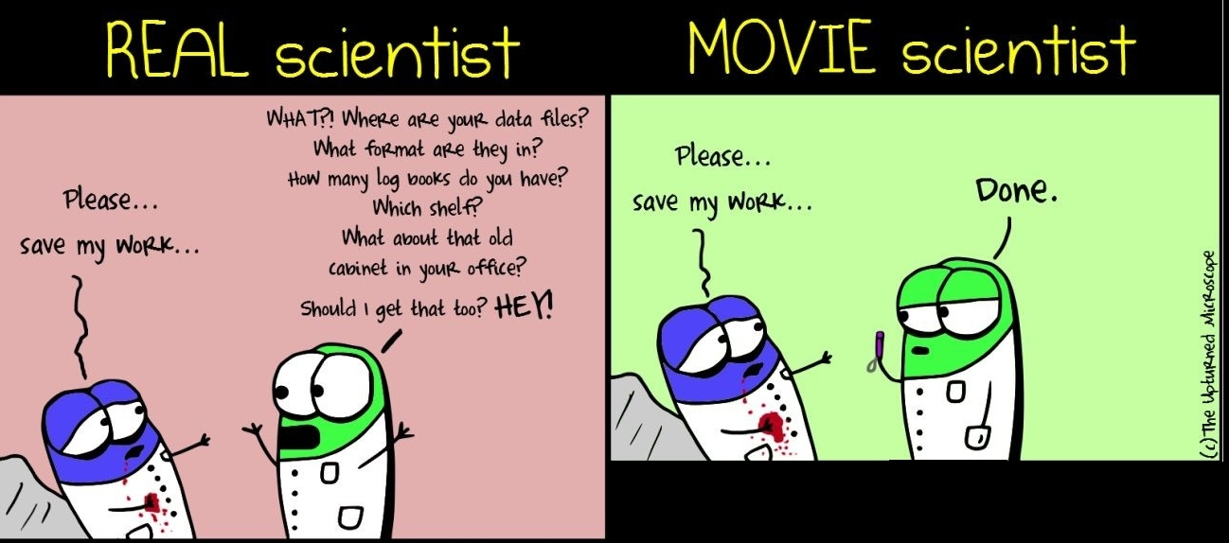
https://theupturnedmicroscope.com/comic/real-vs-movie-scientist-3/ The Upturned Microscope by Nik Papageorgiou is licensed under a Creative Commons Attribution-NonCommercial-NoDerivs 3.0 Unported License

Slide 15

Documentation
File naming conventions
Folder structures
Automation
Version control
You will help an outsider understand how your research project or experiment works when you document procedures and processes.
Photo by Sharon McCutcheon on Unsplash

Slide 16



Document what?
Original research proposal
Grant application(s)
Location of your results and working data
Lab notebook if you have a digital one
Collaborators
Ethics applications and outcomes
Data sharing agreements with others
Data management plans
Documentation is a love letter to your future self …
Damian Conway
Documentation can also play an important part in any audits of your lab or project.

Slide 17

ALL: How to start documenting and more *
Beginner:
Start by documenting in a text file or spreadsheet.
Sync the document to the cloud with your data
Keep the document in a shared place such as Microsoft teams or Sharepoint.
Intermediate:
Once you have the basics in place, provide detail on how your workflow moves from raw data to final results.
This could be a downloaded function list from SPSS/Nvivo, or the R or Python code used to create it.
Advanced:
Now that you've got a good head start, learn about shared documentation tools such as Git repositories and wikis.
Software Carpentry Foundation. Version control with Git.
Cooper, N. & Hsing, P-Y. (Eds.). (2017). A guide to reproducible code in ecology and evolution. British Ecological Society. guide-to-reproducible-code.pdf
* CESSDA ERIC. (2020a). Documentation and metadata. In CESSDA Training Team (Eds.), CESSDA Data management expert guide. Documentation and metadata - CESSDA TRAINING

Slide 18
Documentation
File naming conventions
Folder structures
Automation
Version control
A file naming convention is a framework or protocol that enables you to systematically name your files in a way that describes what files contain and, importantly, how they relate to other files.
Try to establish an agreed file naming convention before collecting any data.
Document your file naming convention as a README file in your main shared project folder.
Useful in orientation process for new team members, and as an aide memoire for the team (and yourself).
University of Edinburgh. (2019). Records management: Naming conventions.

Slide 19
Benefits
Easier to process – team members won't have to over-think the process
Easier to facilitate access, retrieval and storage of files, e.g., by date or topic
Easier to browse
Harder to misplace or lose files
Helps with version control
Easy to identify obsolete or duplicate records
Vocabulary - choose a standard vocabulary, so that everyone uses a common language
Punctuation - decide when to use what punctuation symbols, capitals, hyphens, dashes or underscores
Dates - agree on use of dates so that they display chronologically, i.e. YYYY-MM-DD
Numbering – left-pad numbers with zeroes so they file logically

Slide 20
Principles
regular expression and globbing friendly
avoid spaces, punctuation, accented characters, case sensitivity
easy to compute on
deliberate use of delimiters
machine readable
human readable
plays well with default ordering
filenames contain info on content
put something numeric first
use a standard system for dates
left pad other numbers with zeroes

Slide 21

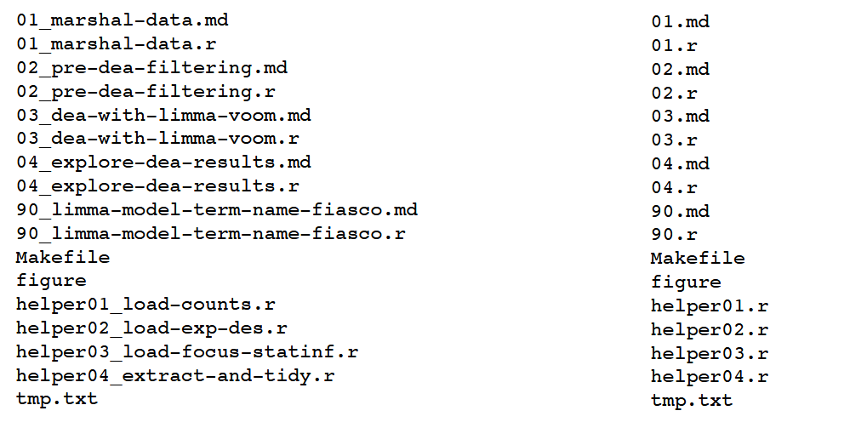
Human readable file names
Which set of file(name)s do you want at 3 a.m. before a deadline?

Slide 22
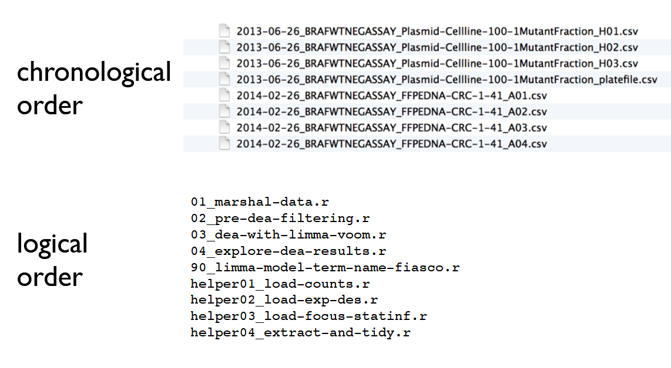
Agree as a research team or lab on:
Order - confirm which element should go first, so that files on the same theme are listed together and can therefore be found easily.
Numbers - specify the number of digits to left pad the numbers so that files are listed numerically e.g., 01, 002, etc.
Source: http://www2.stat.duke.edu/~rcs46/lectures_2015/01-markdown-git/slides/naming-slides/naming-slides.pdf

Slide 23
Avoid using these characters in a filename
/ \ “ ‘ * ; - ?
[ ] ( ) ~ ! $
{ } & > # @ |
spaces tabs new lines
Some characters may have special meaning to the operating system so avoid using these when you are naming files.
Source: https://www.ibm.com/support/knowledgecenter/en/ssw_aix_71/com.ibm.aix.osdevice/filename_conv.htm

Slide 24
References
Naming things by Jenny Bryan Easy to view slideshow
File naming and folder conventions by CESSDA ERIC - Provides file naming strategies
University of Edinburgh has a comprehensive but easy to follow 13 step rule https://www.ed.ac.uk/records-management/guidance/records/practical-guidance/naming-conventions

Slide 25

Using a standard folder structure keeps your research files tidy and saves you time looking for data or content.
Using a standard place to store working data and documentation facilitates file sharing with colleagues.
Documentation
File naming conventions
Folder structures
Automation
Version control

Slide 26
Documentation
File naming conventions
Folder structures
Automation
Version control
Like files, folders can follow a naming convention.
By prefixing with numbers, you can force your files and folders to be ordered to match the steps in your workflow.
Good practice is to document your folder structure for future reference in a shared README file.

Slide 27
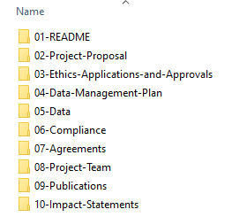
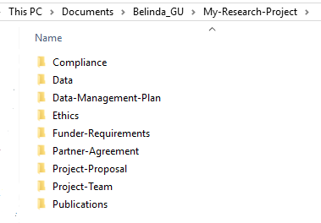
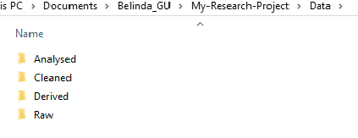
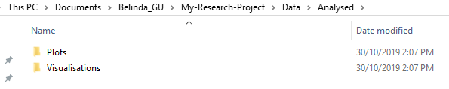
Project data structure
Using numbers
Establish good practices at the very start of a new project
Use a strong project folder structure combined with a file naming protocol
Notes:
Just step people through this

Slide 28
To develop a logical structure for your team, consider these points:
Check to make sure there are no pre-existing folder structure agreements
Name folders appropriately. Don't use staff names
Consistency - make sure you use the agreed structure/hierarchy
Start with a limited number of folders for the broader topics, then create more specific folders within these
Separate your older documents from those you are currently working on

Slide 29
Once you have developed your folder structure and file naming convention:
Ensure folders and files are backed up and retrievable.
Clean up folders and files post-project.
Test your ability to restore your files from a backup.

Slide 30
Beginner:
Pick a dataset and illustrate how you currently organise your files.
(For the artists: Draw a picture that describes your current approach to file organisation)
Consider what your folder hierarchy might look like.
Intermediate:
Devise a better naming convention or note one or two improvements you could make to the way you currently name your files.
Create a folder template and put it in a downloadable location for the project team to access.
Advanced:
Come up with a policy for your group for folder structures.
If you have several data collections, consider creating a separate data folder for each one.
Download a template for your folders

Slide 31
Documentation
File naming conventions
Folder structures
Automation
Version control

Slide 32

Repetitive tasks that need to be done by a human provide opportunities for human error.
Automating routine tasks can eliminate this risk.
Automation includes anything from a formula or macro within Excel to coding in a tool like Python or R.
Could you code your workflow so it is completely automated?

Slide 33

Let's think about the repetitive tasks that you could automate ...
Do you always rename files the same way?
Do you manually copy files to new locations?
Do you regularly create backup copies of files?
Ways to automate
Macros and formulas in spreadsheets
MacOS - Automator
Windows 10 - Task scheduler
Microsoft Power Automate
Coding in Python or R

Slide 34
Documentation
File naming conventions
Folder structures
Automation
Version control

Slide 35



A version control system helps you keep track of changes in your data or research process
Do you keep track of versions or logs made by the software you use?
Make sure you have a copy of every step you have completed and, if possible, version numbers for the software program you are using and any related libraries.
Software programs change over time. This can affect your results if someone tries to replicate your work post-publication.
Keep track of software versions of any instruments you use as well.

Slide 36

Never make alterations to your raw data files!
Make a copy of any raw data files and keep them somewhere safe. That way, if you need to redo your work or you find an error earlier in your workflow, you will always have an original baseline to start from.

Slide 37








Random Number Generator
If you are using random numbers in your research, save your random seed generator number as part of your working data. This way, you can later reproduce your results.

Slide 38
Beginner:
Replicate your raw data in cloud storage.
Intermediate:
Test the RESTORE process for your raw data housed in cloud storage.
Advanced:
If you are writing scripts, e.g., R, Python, Matlab, shell scripts, use a version control system such as Git to manage them.
Regarding code:
If you plan to publish and share any Git repositories, protect your work with a copyright licence.

Slide 39
Internal Resources
Workshops on how to use git are available through QCIF
External Resources
Reproducible research in Git
What is git
Reproducibility in SPSS
Learn Software Carpentry in Git

Slide 40

Great!
By implementing these steps, we've already improved our processes!
Now if someone leaves our lab or project, we're covered!
Next scenario ...

Slide 41

Imagine you’re travelling and you lose your laptop bag with your external hard drives?
Or what if your office is burgled? Or damaged in a fire?
Could you continue your work?
Is your data backed up?
Is it encrypted?
Keep a copy of your data on the cloud
Keeping a cloud-based copy of all your data (working, raw and completed) is incredibly important.
This ensures that if you have a computer failure, accidently delete your data or if your data is corrupted, your research is restorable.

Slide 42
Data quality
Documentation
File naming conventions
Folder structures
Automation
Version control
Backing up to the cloud
Computer security
De-identify data
Publish data with persistent identifiers
Photo by Jukan Tateisi on Unsplash

Slide 43
Beginner:
Store a copy of your data in the locally provided research storage at your institution.
Intermediate:
Make sure the location of your data and backups is part of your documentation.
Advanced:
Create a policy with your team or group on where data should be stored.
Make sure the location of your data is part of your documentation.

Slide 44
Data quality
Documentation
File naming conventions
Folder structures
Automation
Version control
Backing up to the cloud
Computer security
De-identify data
Publish data with persistent identifiers
Photo by Jukan Tateisi on Unsplash

Slide 45
Securing your computer and network means that you have far less risk of a data breach or hack.
Encrypt your computer
Win 10 Encryption: https://www.windowscentral.com/how-use-bitlocker-encryption-windows-10
Win 7 Encryption: https://www.microsoft.com/en-au/download/details.aspx?id=4794
Mac OS https://support.apple.com/en-au/HT204837
Microsoft. (2012). Bitlocker drive encryption (Version 1) [Computer software]. Microsoft Download Center. Download Protect Data with Windows 7 BitLocker Get Started from Official Microsoft Download Center
Huculak, M. (2021, May 14). How to use Bitlocker Drive Encryption on Windows 10. WindowsCentral.com. How to use BitLocker Drive Encryption on Windows 10 | Windows Central
Apple Australia. (2018, November 30). Use FileVault to encrypt the startup disk on your Mac. Use FileVault to encrypt the startup disk on your Mac – Apple Support (AU)

Slide 46
Staying safe
Use strong passwords
Are your passwords strong enough?
https://youtu.be/PjHc8g8G9MU
Is your email compromised ?
https://haveibeenpwned.com/
Use a password manager such as LastPass
https://www.lastpass.com/business-password-manager
Three steps
Strong passwords
Multi-Factor Authentication
Avoid insecure wifi

Slide 47
Beginner:
Create good strong passwords
Encrypt your computer's hard drive
Intermediate:
Use a password manager
Advanced:
Encrypt your lab/office computers
Practise safe habits within the team

Slide 48
Data quality
Documentation
File naming conventions
Folder structures
Automation
Version control
Backing up to the cloud
Computer security
De-identify data
Publish data with persistent identifiers
Photo by Jukan Tateisi on Unsplash

Slide 49

Separating or de-identifying data generally occurs to protect an individual’s privacy.
It may also be used to protect the location of archaeological findings or the habitats of endangered plant or animal species.
According to the Commonwealth Privacy Act 1988,
“personal information is de-identified if the information is no longer about an identifiable individual or an individual who is reasonably identifiable”.
De-identified information is no longer considered personal information and can be shared.
More information on the Privacy Act https://www.legislation.gov.au/Details/C2016C00979
De-identification
aims to allow data to be published, shared and re-used without the possibility of individuals or locations being re-identified.

Slide 50


Sensitive data – and how to use it safely
Sensitive data are data that can be used to identify an individual, species, object, or location that introduces a risk of discrimination, harm, or unwanted attention.
Major categories of sensitive data are:
personal data, e.g.,
health data
medical data
ecological data that may place vulnerable species or locations at risk.
De-identification
Any identifiers (name, date of birth, address or geospatial locations) should be removed from the main data set and replaced with a code/key. The code/key is then preferably encrypted and stored separately. By storing de-identified data in a secure solution, you are meeting safety, controlled, ethical, privacy and funding agency requirements.
Re-identification of individuals is possible by recombining the de-identifiable data set and the identifiers.
ARDC Identifiable data:
https://ardc.edu.au/resources/working-with-data/sensitive-data/identifiable-data/

Slide 51
Plan
Plan de-identification early on in the research
Retain
Retain original unedited versions of data for use within the research team and for preservation
Create
Create a de-identification log of all replacements, aggregations or removals made
Store
Store the log separately from the de-identified data files
Identify
Identify replacements in text, e.g., in transcribed interviews, indicate replaced text with [brackets] or use XML markup tags

Slide 52
Data may often need to be identifiable (i.e. containing personal information) during the analysis phase of research.
If so, comply with ethical and privacy requirements through access control and data security, such as
Control of access through physical or digital means (e.g., password protection, compliance checklists)
Encryption of data, particularly if it is being moved between locations
Ensuring data is not stored unencrypted on easily lost items such as USB, laptops or external hard drives.
Taking all reasonable actions to prevent the inadvertent disclosure, release or loss of sensitive personal information.
https://ardc.edu.au/resources/working-with-data/sensitive-data/

Slide 53



Your project has finished!
BUT
someone has published work contradicting the results in your published paper.
You’ve been asked to provide your data and methods.
Could you?

Slide 54

We’ve already covered some things that can help us
Storing our data in the cloud
Documentation
Versions of software

Slide 55
Data quality
Documentation
File naming conventions
Folder structures
Automation
Version control
Backing up to the cloud
Computer security
De-identify data
Publish data with persistent identifiers
Photo by Jukan Tateisi on Unsplash

Slide 56
Now for this one … Publish data with persistent identifiers
final STATE DATA
PUBLISHED FINDINGS
SHARED & Linked with
persistent ids
Notes:
So in this scenario we have been asked to provide our data and methods to support or verify our published findings.
We can find the data because we organised it and stored it securely.
But how do we make the final state data available to peer reviewers, our funding bodies, other researchers or practitioners?
We can publish it with the article or deposit it in a data repository and importantly give it a persistent identifier.

Slide 57



Identifiers vs persistent identifiers
DOI
SERIAL Numbers
uRLS
ORCID
Digital Object Identifier
Management not guaranteed:
links disappear
websites shut down
product support ends
Management guaranteed over time:
links find the object
even when websites change
Notes:
An identifier is any label used to name some thing uniquely (whether digital or physical).
URLs are an example of an identifier. So are serial numbers or personal names.
A persistent identifier (PiDs) is guaranteed to be managed and kept up to date over a defined time period.
DOIs are also considered a type of persistent identifier and are given to publications and data.
ORCIDs are a persistent id given to researchers and can move with them across their career.
They are managed by organisations that want to ensure research is available over time and are not lost when websites change.

Slide 58
Persistent identifiers - DOIs
DOI
A Digital Object Identifier (DOI) is a unique alphanumeric string that identifies content and provides a persistent link to its location on the internet
DOI might look like
http://dx.doi.org/10.4225/01/4F8E15A1B4D89
or
https://research-repository.griffith.edu.au/handle/10072/394379
The DOI or Identifier is listed in the middle of this record from Griffith’s Research Data Repository.
Notes:
A Digital Object Identifier (DOI) is a unique alphanumeric string that identifies content and provides a persistent link to its location on the internet
DOI might look like http://dx.doi.org/10.4225/01/4F8E15A1B4D89.
or
https://research-repository.griffith.edu.au/handle/10072/394379
The DOI or Identifier is listed in the middle of this record from Griffiths' Research Data Repository.
So how do you get a DOI for your data?

Slide 59

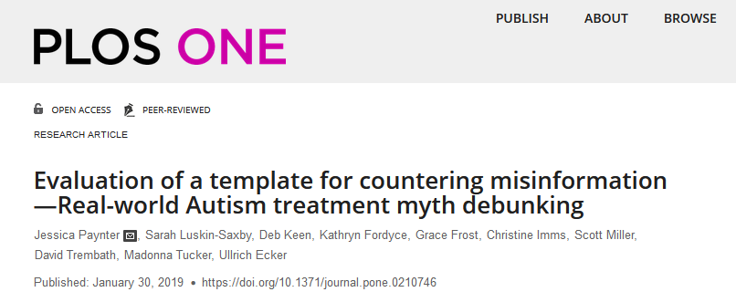
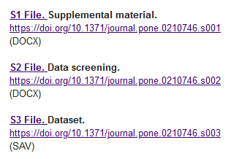
Data publishing and DOIs
Journal publishers assign DOIs to electronic versions of individual articles & datasets.
Article
Dr Jessica Paynter
Datasets linked in article
DOIs
Data citation
Paynter, J., Luskin-Saxby, S., Keen, D., Fordyce, K., Frost, G., Imms, C., Miller, S., Trembath, D., Tucker, M., & Ecker, U.. (2019). Evaluation of a template for countering misinformation—Real-world Autism treatment myth debunking (Version 1). PLOS ONE. https://doi.org/10.1371/journal.pone.0210746
Notes:
Journal publishers assign DOIs to electronic versions of individual articles.
Here we have Griffith researcher Jessica Paynter, she has published a peer reviewed article in PLoS ONE,
which requires that supporting material including a de-identified final state dataset (so not your raw data) be submitted for with the article, for verification and review.
Jessica can link this published data via the DOI. She and other researchers can reuse or refer to the data and cite it with a reference which includes the DOI.

Slide 60

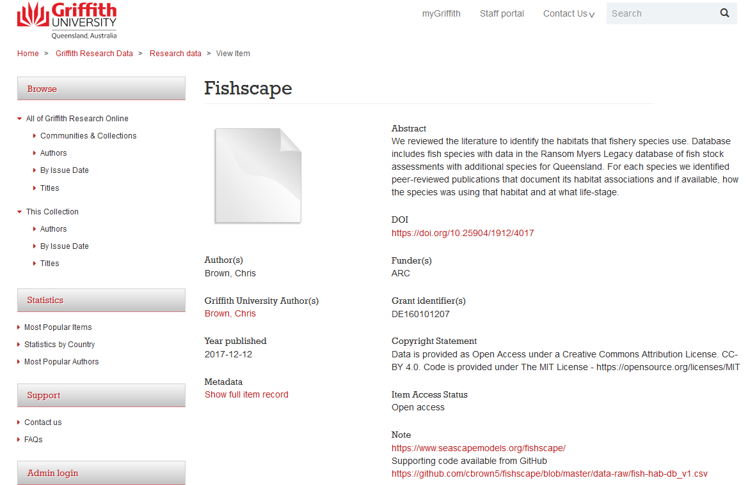
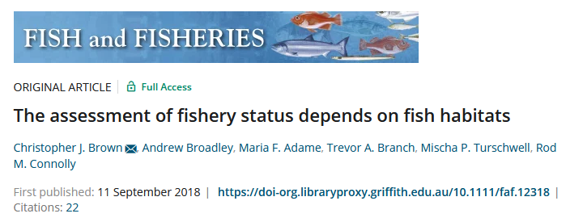
Data publishing and DOIs
Data can be published and DOIs assigned by an organisation such as an online data repository.
Dataset in repository
Dr Chris Brown
Article
DOIs
Data citation
Brown, C.J. & Broadley, A.. (2017). Fishscape. https://doi.org/10.25904/1912/4017
Notes:
Data can be published and DOIs can also be assigned by a repository.
The repository curates your dataset, publishes it with a DOI and metadata to make it attributed to the creators, linked to other research, and given subject tags.
If the repository website changes, the doi is linked to the new website and your audience will still be able to find your research, using the DOI.
They can support citation by Linking datasets to articles, articles to references, references to articles and more.

Slide 61
Beginner:
Learn how using a DOI could increase your citation rate:
Watch this 5m video https://www.youtube.com/watch?v=PgqtiY7oZ6k&feature=youtu.be
Read the ARDC Data Citation Guide
Intermediate:
Ensure data you associate with a publication has a DOI – talk to your library for guidance.
Identifier services: https://ardc.edu.au/services/identifier/
Advanced:
Ensure all data and all associated publications have been assigned DOIs and reference each other.
This will help make your research data discoverable, potentially accessible and re-useable. It will also support reproducible research practices.

Slide 62
Wow, that’s
TEN reproducible research things!
BUT
What if a research partner organisation believes your “sensitive” data has been made available to others (i.e. through a data breach).
Could you show that steps were taken to avoid this or show that it couldn’t happen?

Slide 63
YOU COULD! We’ve learned so many new skills!
Data storage – tracing who has had access to data (Step 6: Backing up to the cloud)
Computer encryption (Step 7: Good Computer Safety)
General good computer safety – using strong passwords and multi-factor authentication (Step 7: Good Computer Safety)
Separating identified variables (Step 8: De-identify your data)

Slide 64
So, what changes are you going to make?

